Slide 1


Day 9 & 10
Math24 (Differential Equations)
Ch 2.3 Modeling with First Order Equations (Page 51-68)
Elementary Differential Equations and Boundary Value Problems, 10th edition, by William E. Boyce and Richard C. DiPrima, ©2013 by John Wiley & Sons, Inc.

Slide 2
Mathematical models characterize physical systems, often using differential equations.
Model Construction: Translating physical situation into mathematical terms. Clearly state physical principles believed to govern process. Differential equation is a mathematical model of process, typically an approximation.
Analysis of Model: Solving equations or obtaining qualitative understanding of solution. May simplify model, as long as physical essentials are preserved.
Comparison with Experiment or Observation: Verifies solution or suggests refinement of model.

Slide 3
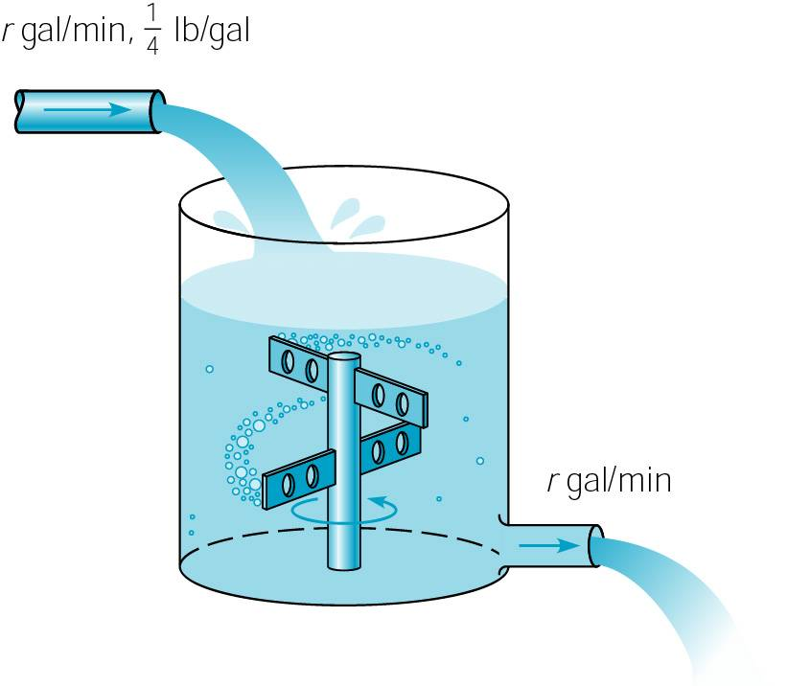
Example 1: Salt Solution (1 of 7)
At time t = 0, a tank contains Q₀ lb of salt dissolved in 100 gal of water. Assume that water containing ¼ lb of salt/gal is entering tank at rate of r gal/min, and leaves at same rate.
  (a) Set up IVP that describes this salt solution flow process.
  (b) Find amount of salt Q(t) in tank at any given time t.
  (c) Find limiting amount Q_{L} of salt Q(t) in tank after a very long time.
  (d) If r = 3 & Q₀ = 2Q_{L} , find time T after which salt is within 2% of Q_{L} .
  (e) Find flow rate r required if T is not to exceed 45 min.

Slide 4

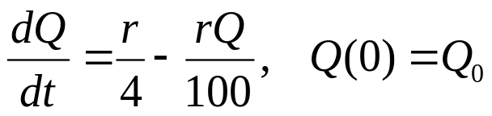
Example 1: (a) Initial Value Problem (2 of 7)
At time t = 0, a tank contains Q₀ lb of salt dissolved in 100 gal of water. Assume water containing ¼ lb of salt/gal enters tank at rate of r gal/min, and leaves at same rate.
Assume salt is neither created or destroyed in tank, and distribution of salt in tank is uniform (stirred). Then
Rate in: (1/4 lb salt/gal)(r gal/min) = (r/4) lb/min
Rate out: If there is Q(t) lbs salt in tank at time t, then concentration of salt is Q(t) lb/100 gal, and it flows out at rate of [Q(t)r/100] lb/min.
Thus our IVP is

Slide 5
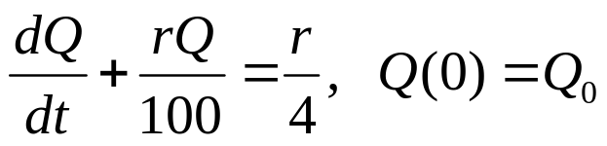

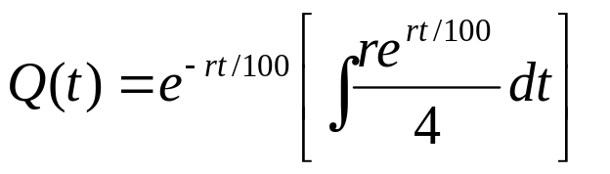



Example 1: (b) Find Solution Q(t) (3 of 7)
To find amount of salt Q(t) in tank at any given time t, we need to solve the initial value problem
To solve, we use the method of integrating factors:
or

Slide 6
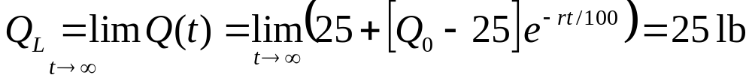
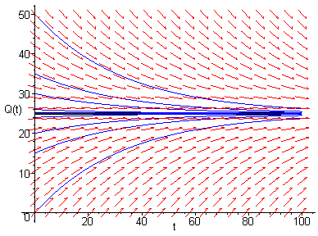
Example 1:
(c) Find Limiting Amount Q_{L} (4 of 7)
Next, we find the limiting amount Q_{L} of salt Q(t) in tank after a very long time:
This result makes sense, since over time the incoming salt solution will replace original salt solution in tank. Since incoming solution contains 0.25 lb salt / gal, and tank is 100 gal, eventually tank will contain 25 lb salt.
The graph shows integral curves
for r = 3 and different values of Q₀.

Slide 7

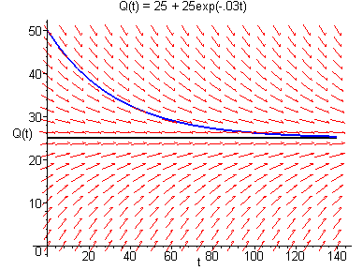


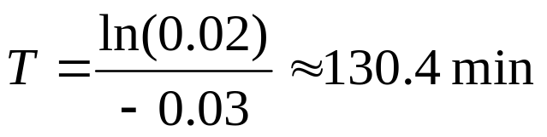
Example 1: (d) Find Time T (5 of 7)
Suppose r = 3 and Q₀ = 2Q_{L} . To find time T after which Q(t) is within 2% of Q_{L} , first note Q₀ = 2Q_{L} = 50 lb, hence
Next, 2% of 25 lb is 0.5 lb, and thus we solve

Slide 8

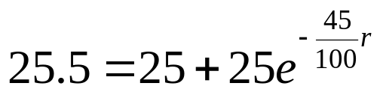
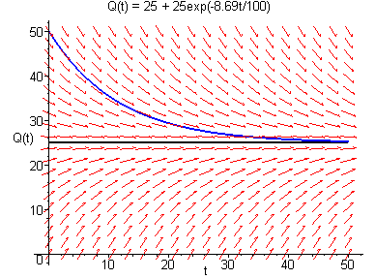


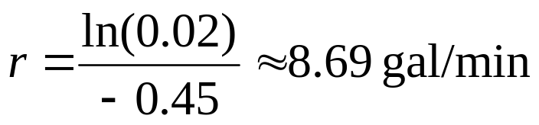
Example 1: (e) Find Flow Rate (6 of 7)
To find flow rate r required if T is not to exceed 45 minutes, recall from part (d) that Q₀ = 2Q_{L} = 50 lb, with
and solution curves decrease from 50 to 25.5.
Thus we solve

Slide 9
Example 1: Discussion (7 of 7)
Since situation is hypothetical, the model is valid.
As long as flow rates are accurate, and concentration of salt in tank is uniform, then differential equation is accurate description of flow process.
Models of this kind are often used for pollution in lake, drug concentration in organ, etc. Flow rates may be harder to determine, or may be variable, and concentration may not be uniform. Also, rates of inflow and outflow may not be same, so variation in amount of liquid must be taken into account.

Slide 10
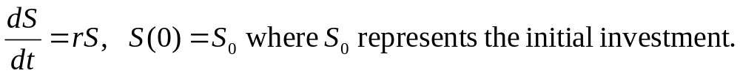
Example 2: Compound Interest (1 of 3)
If a sum of money is deposited in a bank that pays interest at an annual rate, r, compounded continuously, the amount of money (S) at any time in the fund will satisty the differential equation:
The solution to this differential equation, found by separating the variables and solving for S, becomes:
Thus, with continuous compounding, the amount in the account grows exponentially over time.

Slide 11


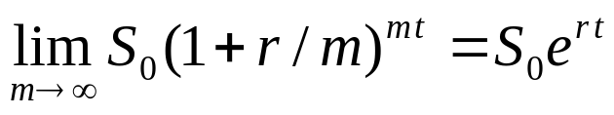
Example 2: Compound Interest (2 of 3)
In general, if interest in an account is to be compounded m times a year, rather than continuously, the equation describing the amount in the account for any time t, measured in years, becomes:
The relationship between these two results is clarified if we recall from calculus that
Growth of Capital at a Return Rate of r = 8% For Several Modes of Compounding: S(t)/S(0) |  |  |  | A comparison of the accumulation of funds for quarterly, daily, and continuous compounding is shown for short-term and long-term periods.
t | m = 4 | m = 365 | exp(rt)
Years | Compounded Quarterly | Compounded Daily | Compounded Continuously
1 | 1.082432 | 1.083278 | 1.083287
2 | 1.171659 | 1.17349 | 1.173511
5 | 1.485947 | 1.491759 | 1.491825
10 | 2.20804 | 2.225346 | 2.225541
20 | 4.875439 | 4.952164 | 4.953032
30 | 10.76516 | 11.02028 | 11.02318
40 | 23.76991 | 24.52393 | 24.53253

Slide 12
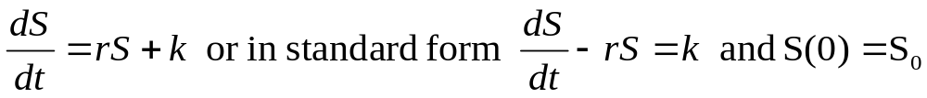

Example 2: Deposits and Withdrawals (3 of 3)
Returning now to the case of continuous compounding, let us suppose that there may be deposits or withdrawals in addition to the accrual of interest, dividends, or capital gains. If we assume that the deposits or withdrawals take place at a constant rate k, this is described by the differential equation:
where k is positive for deposits and negative for withdrawals.
We can solve this as a general linear equation to arrive at the solution:
To apply this equation, suppose that one opens an IRA at age 25 and makes annual investments of $2000 thereafter with r = 8%.
At age 65,

Slide 13
Example 3: Pond Pollution (1 of 7)
Consider a pond that initially contains 10 million gallons of fresh water. Water containing toxic waste flows into the pond at the rate of 5 million gal/year, and exits at same rate. The concentration c(t) of toxic waste in the incoming water varies periodically with time:
c(t) = 2 + sin 2t g/gal
(a) Construct a mathematical model of this flow process and determine amount Q(t) of toxic waste in pond at time t.
(b) Plot solution and describe in words the effect of the variation in the incoming concentration.

Slide 14
Example 3: (a) Initial Value Problem (2 of 7)
Pond initially contains 10 million gallons of fresh water. Water containing toxic waste flows into pond at rate of 5 million gal/year, and exits pond at same rate. Concentration is c(t) = 2 + sin 2t g/gal of toxic waste in incoming water.
Assume toxic waste is neither created or destroyed in pond, and distribution of toxic waste in pond is uniform (stirred).
Then
Rate in: (2 + sin 2t g/gal)(5 x 10⁶ gal/year)
Rate out: If there is Q(t) g of toxic waste in pond at time t, then concentration of salt is Q(t) lb/10⁷ gal, and it flows out at rate of [Q(t) g/10⁷ gal][5 x 10⁶ gal/year]

Slide 15
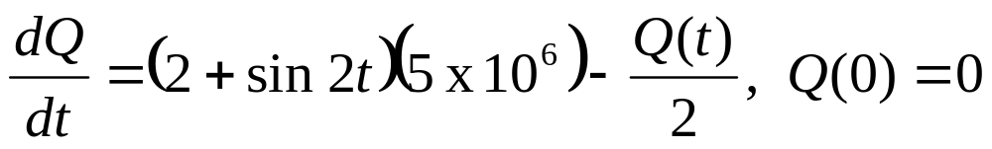
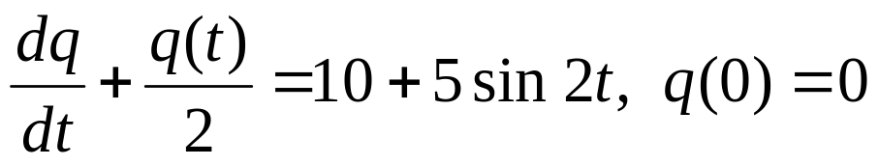
Example 3:
(a) Initial Value Problem, Scaling (3 of 7)
Recall from previous slide that
  Rate in: (2 + sin 2t g/gal)(5 x 10⁶ gal/year)
  Rate out: [Q(t) g/10⁷ gal][5 x 10⁶ gal/year] = Q(t)/2 g/yr.
Then initial value problem is
Change of variable (scaling): Let q(t) = Q(t)/10⁶. Then

Slide 16


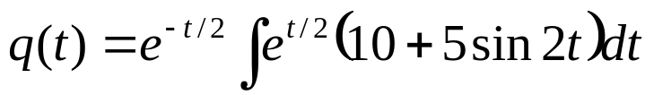
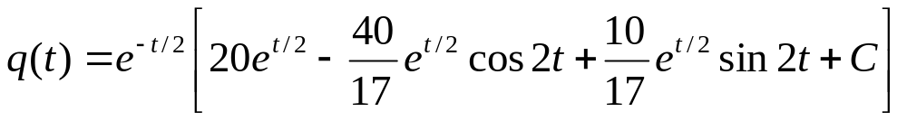
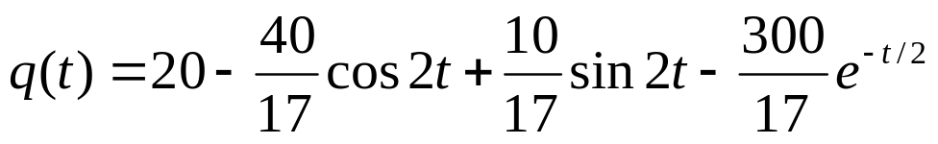
Example 3:
(a) Solve Initial Value Problem (4 of 7)
To solve the initial value problem
we use the method of integrating factors:
Using integration by parts (see next slide for details) and the initial condition, we obtain after simplifying,

Slide 17
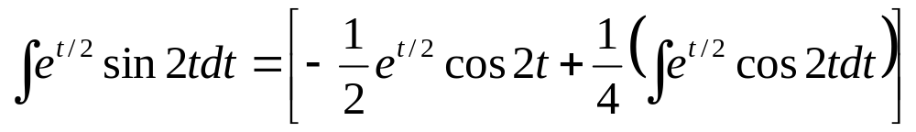
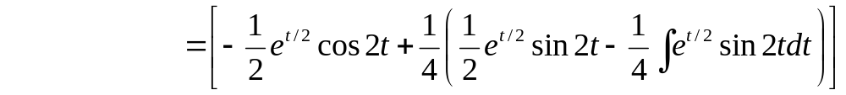
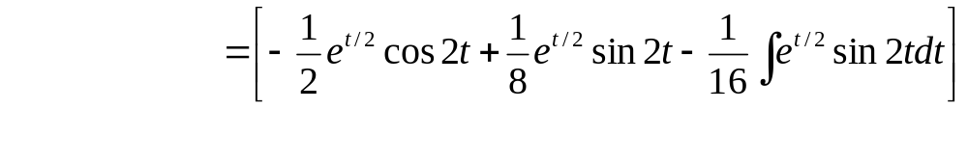
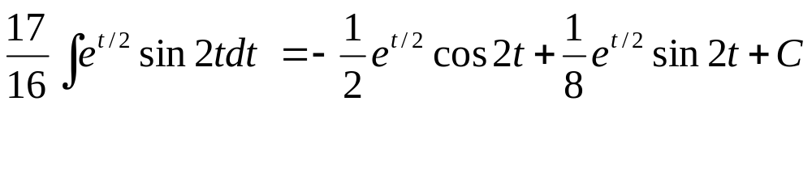
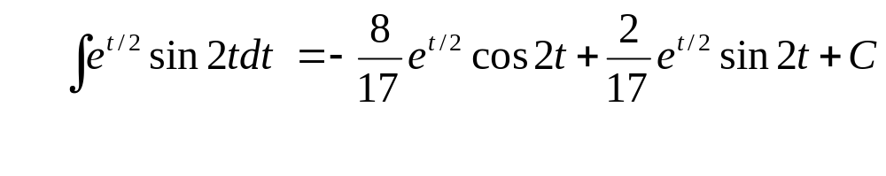
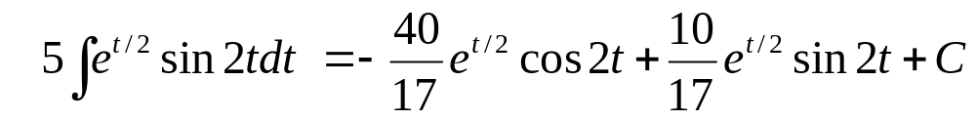
Example 3: (a) Integration by Parts (5 of 7)

Slide 18
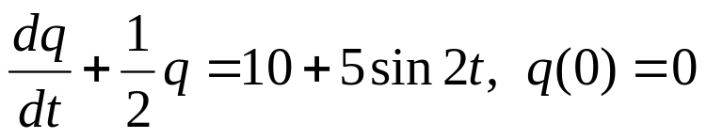

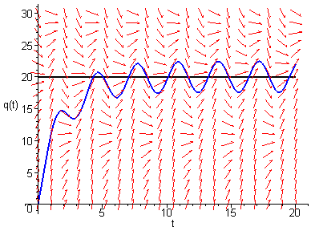
Example 3: (b) Analysis of solution (6 of 7)
Thus our initial value problem and solution is
A graph of solution along with direction field for differential equation is given below.
Note that exponential term is
important for small t, but decays
away for large t. Also, y = 20
would be equilibrium solution
if not for sin(2t) term.

Slide 19
Example 3:
(b) Analysis of Assumptions (7 of 7)
Amount of water in pond controlled entirely by rates of flow, and none is lost by evaporation or seepage into ground, or gained by rainfall, etc.
Amount of pollution in pond controlled entirely by rates of flow, and none is lost by evaporation, seepage into ground, diluted by rainfall, absorbed by fish, plants or other organisms, etc.
Distribution of pollution throughout pond is uniform.

Slide 20
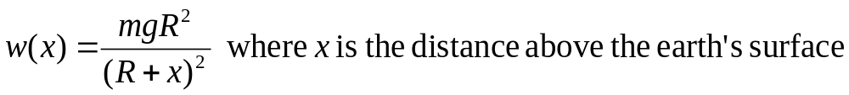
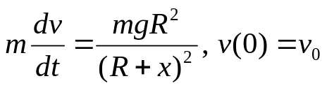
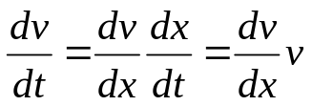
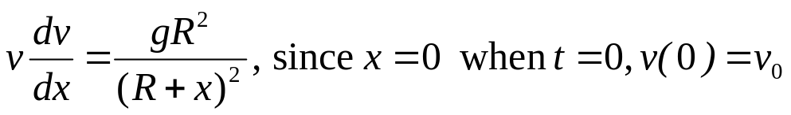
Example 4: Escape Velocity (1 of 2)
A body of mass m is projected away from the earth in a direction perpendicular to the earth’s surface with initial velocity v0 and no air resistance. Taking into account the variation of the earth’s gravitational field with distance, the gravitational force acting on the mass is
R is the radius of the earth and g is the acceleration due to gravity at the earth’s surface. Using Newton’s law F = ma,
Since and cancelling the m’s, the differential equation becomes

Slide 21
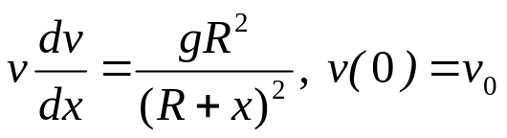
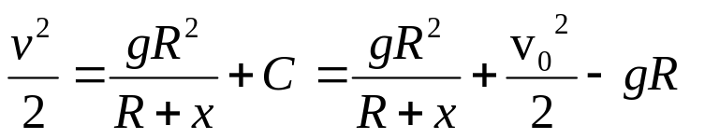
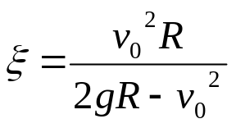
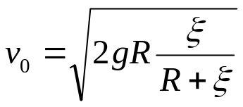

Example 4: Escape Velocity (2 of 2)
We can solver the differential equation by separating the variables and integrating to arrive at:
The maximum height (altitude) will be reached when the velocity is zero. Calling that maximum height ξ, we have
We can now find the initial velocity required to lift a body to a height ξ : and, taking the limit as ξ→∞, we get
the escape velocity, representing the initial velocity required to escape earth’s gravitational force:
Notice that this does not depend on the mass of the body.

